Slide 1
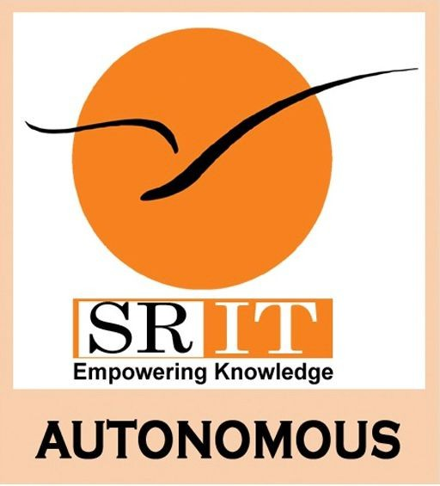
Smart College Bus Tracking System Using Hybrid GPS and AI Chatbot
by
R.ARUN KUMAR NAIK
Roll No. 224G1A0507
P.Md.MANSOOR
Roll No. 224G1A0545
G.SRAVANI
Roll No. 234G5A05A3
Under the guidance of
Dr. S. Ravi Kumar Ph.D.
Associate Professor
Department of Computer Science and Engineering
Srinivasa Ramanujan Institute of Technology
Autonomous
Rotarypuram Village, B K Samudram Mandal, Ananthapuramu – 515701.
2025-2026
A-25
Dept. of Computer Science and Engineering
Srinivasa Ramanujan Institute of Technology
1

Slide 2
Contents
Smart College Bus Tracking System Using Hybrid GPS and AI Chatbot
Title Justification
Abstract
Problem statement
Objectives of Project
Literature survey for objectives
Proposed Work -(Methods to be followed for proposed system)
References
GitHub Link
Queries
Srinivasa Ramanujan Institute of Technology

Slide 3
Title Justification
Smart College Bus Tracking System Using Hybrid GPS and AI Chatbot
The title “Smart College Bus Tracking System Using Hybrid GPS and AI Chatbot” is suitable because the project focuses on providing a reliable and intelligent solution for real-time college bus tracking. The system uses a hybrid GPS approach, where both a mobile phone and a dedicated GPS device are used to ensure continuous and accurate bus location tracking without interruption.
In addition, the integration of an AI chatbot enables effective and instant communication by answering student queries related to bus location, arrival time, routes, and delays. Since the project combines smart tracking, backup reliability, and intelligent communication to improve transportation convenience and management, the title clearly reflects the purpose and functionality of the system.
Srinivasa Ramanujan Institute of Technology

Slide 4
Abstract
Smart College Bus Tracking System Using Hybrid GPS and AI Chatbot
This project presents a Smart College Bus Tracking System designed to provide reliable real-time bus location information using a hybrid GPS approach and AI-based communication. Traditional bus tracking systems either rely on costly GPS hardware or manual communication methods, which often lead to interruptions and inconvenience. To overcome these limitations, the proposed system combines mobile-based GPS tracking with a dedicated GPS tracking device, ensuring uninterrupted and accurate bus location updates.
The system is developed with three main modules: Admin, Driver, and Student. The Admin module allows administrators to manage buses, drivers, students, routes, and complaints through a centralized platform. The Driver module enables drivers to update live bus locations using a mobile application, while the GPS device acts as a backup source for continuous tracking. The Student module provides real-time bus tracking, estimated arrival time (ETA), stop-based alerts, route details, and complaint submission through a web or mobile interface.
To enhance communication, an AI chatbot is integrated into the system, enabling students to instantly query bus location, arrival time, and other transportation-related information without manual intervention. This reduces dependency on phone calls or messaging applications and improves response time.
Overall, the proposed system improves transportation reliability, reduces waiting time, enhances user convenience, and ensures effective communication. By using cloud computing, hybrid GPS tracking, and AI-based interaction, the system offers a smart, scalable, and cost-effective solution for college transportation management.
Srinivasa Ramanujan Institute of Technology

Slide 5
Problem Statement
Smart College Bus Tracking System Using Hybrid GPS and AI Chatbot
Students in many educational institutions face uncertainty about bus arrival times due to the lack of real-time updates and efficient communication. Traditional methods like phone calls or manual announcements are unreliable, causing delays, missed buses, and inconvenience. Administrators struggle to manage buses, drivers, routes, and complaints effectively, while drivers lack a structured platform for live updates.
A centralized, smart system is needed that combines mobile and device-based GPS tracking, real-time location updates, estimated arrival times, stop alerts, AI-based query handling, and complaint management. Such a system will improve transportation reliability, reduce waiting time, and enhance communication for students, drivers, and administrators.
Srinivasa Ramanujan Institute of Technology

Slide 6
Objectives of Project
Smart College Bus Tracking System Using Hybrid GPS and AI Chatbot
Objective 1:
To develop a real-time college bus tracking system using a hybrid GPS approach (mobile-based GPS with backup GPS device) to provide accurate bus location updates without any interruption
Objective 2:
To enhance user convenience by providing live bus location, estimated arrival time (ETA), stop-based alerts, route details, and complaint submission, along with an AI chatbot for instant query handling.
Srinivasa Ramanujan Institute of Technology

Slide 7
Smart College Bus Tracking System Using Hybrid GPS and AI Chatbot
Literature Survey
Objective : To develop a real-time college bus tracking system using a hybrid GPS approach (mobile-based GPS with backup GPS device) to provide accurate bus location updates without any interruption
Real-time bus tracking has been widely explored using GPS devices and mapping services like Google Maps. Studies show that mobile GPS combined with a backup GPS device and live map visualization can provide accurate location updates. Using real-time data streaming and cloud-based services, students and administrators can track bus movement and estimate arrival times reliably.
Limitation:
Most existing systems rely on dedicated GPS hardware installed in buses, making deployment costly for institutions. Many solutions also lack additional features like ETA prediction, stop-based alerts, and role-based access control.
Example:
Rao et al. (2023) implemented a GPS-based school bus monitoring system, but required expensive tracking hardware.
Singh & Patel (2022) used a mobile phone for location tracking, but the system lacked ETA and student notification features.
Gap:
There is a lack of mobile-based, cost-effective, and smart college bus tracking systems that offer:
- Hybrid GPS tracking (mobile + backup device)
- Live map visualization
- ETA calculation
- Stop-based alerts
- Complaint management
- AI-based communication
- Role-based access for Admin, Driver, and Student
This project bridges the gap by using smartphone GPS and cloud-based real-time location streaming to create an efficient and scalable bus tracking solution.
A-25

Slide 8
Proposed System
Smart College Bus Tracking System Using Hybrid GPS and AI Chatbot
The proposed system is a web and mobile platform to manage college bus transportation efficiently. Students can track buses in real-time, view estimated arrival times (ETA), receive stop-based alerts, and submit complaints. Drivers can update bus locations using a mobile app or backup GPS device, while administrators manage routes, schedules, notifications, and student complaints. An AI chatbot provides instant responses to bus-related queries, making the system reliable, convenient, and transparent for all users.
Srinivasa Ramanujan Institute of Technology

Slide 9
References
Smart College Bus Tracking System Using Hybrid GPS and AI Chatbot
[1] Liu Minghao (2023) developed a real-time bus tracking system using mobile GPS; however, the system did not include route alerts or student-specific notifications.
[2] Rao et al. (2022) implemented a GPS-based school bus monitoring system; however, it required expensive dedicated tracking hardware, making it less suitable for cost-sensitive institutions.
[3] Singh & Patel (2021) used a mobile phone for location tracking, but the system lacked key features such as estimated arrival time (ETA) prediction and personalized student notification alerts.
Srinivasa Ramanujan Institute of Technology

Slide 10
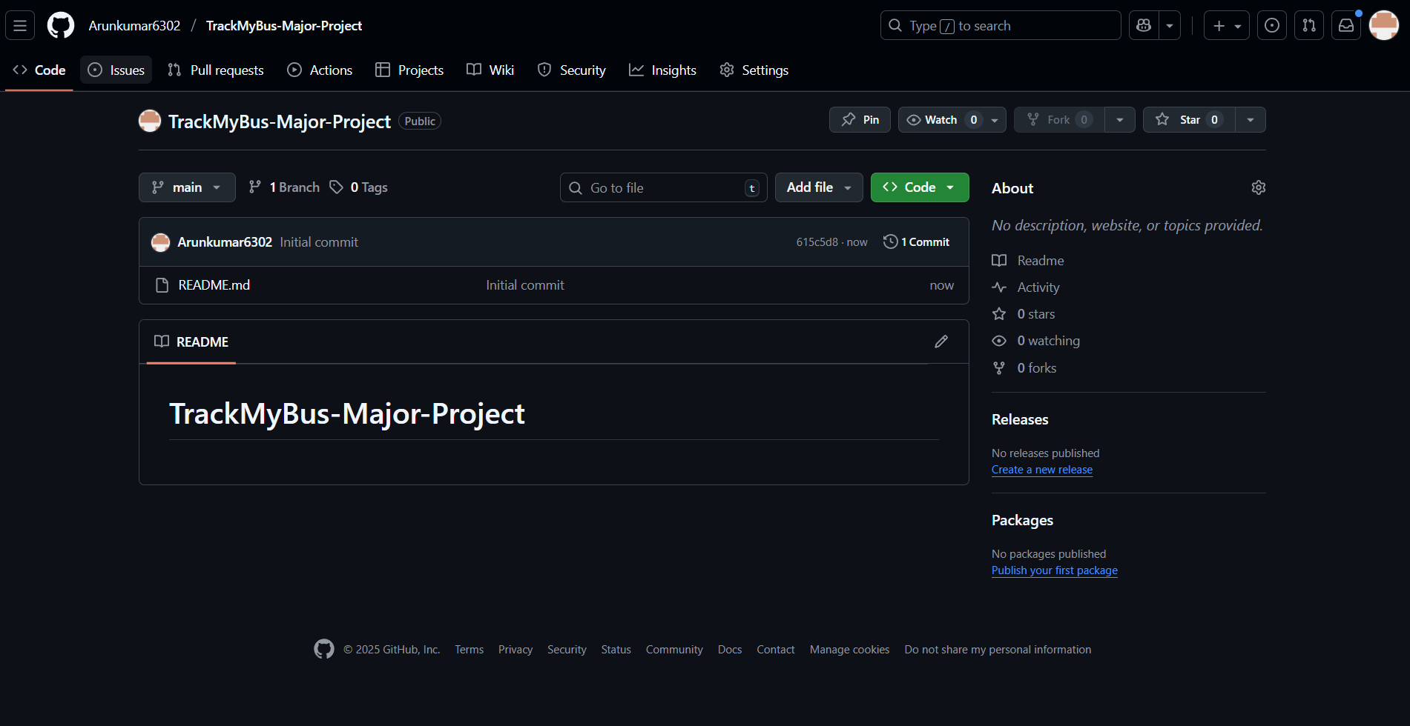
Git Hub Dashboards of each student
Smart College Bus Tracking System Using Hybrid GPS and AI Chatbot
link of the Github : https://github.com/Arunkumar6302/TrackMyBus-Major-Project
Srinivasa Ramanujan Institute of Technology

Slide 11
Any Queries?
Smart College Bus Tracking System Using Hybrid GPS and AI Chatbot
Srinivasa Ramanujan Institute of Technology

